Slide 1

OTMISC: Our Topic Modeling Is Super Cool
Technische Universität München
Fakultät für Informatik
NLP Lab Course, SS22
26.07.2022
Berk Sudan, Ferdinand Kapl, Yuyin Lang
Topic Modeling Advancements

Slide 2
Motivation
‹#›

Slide 3
Motivation
Goal: Identify topics in large unstructured text data (documents)
Method: Cluster documents and associate topic words
Old Approach: Probability based
Advancements: Embedding based
Use Cases:
Recommender systems
Recruiting algorithms
Organize Emails / Customer reviews / Social Media profiles
‹#›

Slide 4
Related Work
Topic Modeling Advancements: Top2Vec, BERTopic, CTM, LDA-BERT…
Issue: No golden standard for evaluation of topic models
Solution: Exhaustive combination of popular used metrics & human based evaluation based on visualizations
Topic Diversity
Topic Coherence
Cluster Based
Unique %
Inverted RBO
NPMI
C_V
Rand Index
‹#›

Slide 5
Architectural Design
‹#›

Slide 6
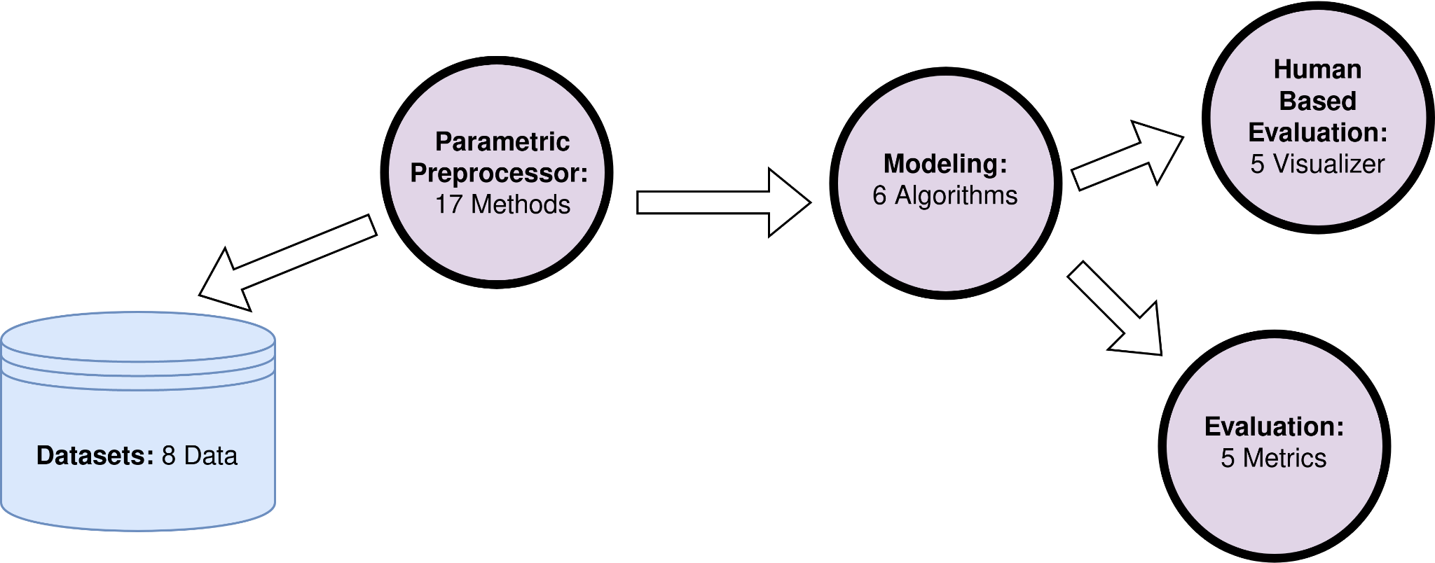
OTMISC Architectural Design
‹#›

Slide 7
Datasets
‹#›

Slide 8
Available Datasets
Currently: 8 Datasets
Long Text Datasets
20 News
Yahoo Answers
AG News - News Text
Short Text Datasets
AG News - News Title
Crisis Resource 1,7,12,17
‹#›

Slide 9
Datasets
Use the screenshot from gitlab, remember to delete ag_news_long
The idea here is to explain the difference of the datasets (not only saying the difference is the length)
1 min here
‹#›

Slide 10
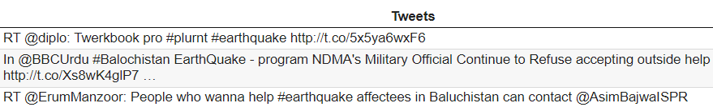
Short Text Data Example (Crisis 12)
Tweets
Often less than 30 words
Contains: URLs, Hashtags, Typos
‹#›

Slide 11
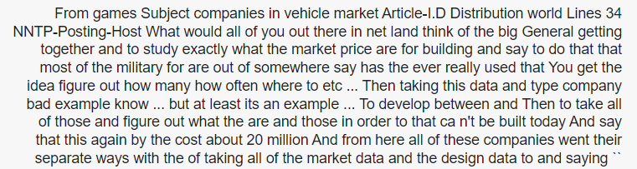
Long Text Data Example (20 News)
News
Often 100+ words
More readable
No Sparsity
‹#›

Slide 12
Preprocessing
‹#›

Slide 13
Preprocessing
Who needs preprocessing? (LDA/NMF definitely, LDA-BERT also, talk about why? BERTopic maybe, but we haven’t done an experiment, maybe do later)
Preprocessing methods? (We can use the slide from midterm)
1 min (or 3 mins for these 2 slides)
‹#›

Slide 14
Preprocessing
LDA, NMF: Use BOW
LDA-BERT: LDA part needs BOW
‹#›

Slide 15
Preprocessing
The essential preprocessing methods:
Lower case
Remove stop words
Lemmatize (to noun)
Special for Tweets:
Remove url
Remove tags
‹#›

Slide 16
Algorithms
Here, I recommend to show the visualization of each algorithms, we agree on one dataset (good to compare, I recommend crisis_12 as 4 topics are easier to show)
in ideal case all visualization methods should be shown, including representative sentences
won’t take long, I would say 4 mins for all the visualization
(Multiple slides, I expect 10+)
‹#›

Slide 17
Technical Part
This is the core of your presentation, show your work ;)
Images for architectures and flows are great
Focus on the details that matter
‹#›

Slide 18
LDA & NMF
‹#›

Slide 19
Algorithms – LDA/NMF
Here, I recommend to show the visualization of each algorithms, we agree on one dataset (good to compare, I recommend crisis_12 as 4 topics are easier to show)
in ideal case all visualization methods should be shown, including representative sentences
won’t take long, I would say 4 mins for all the visualization
(Multiple slides, I expect 10+)
‹#›

Slide 20
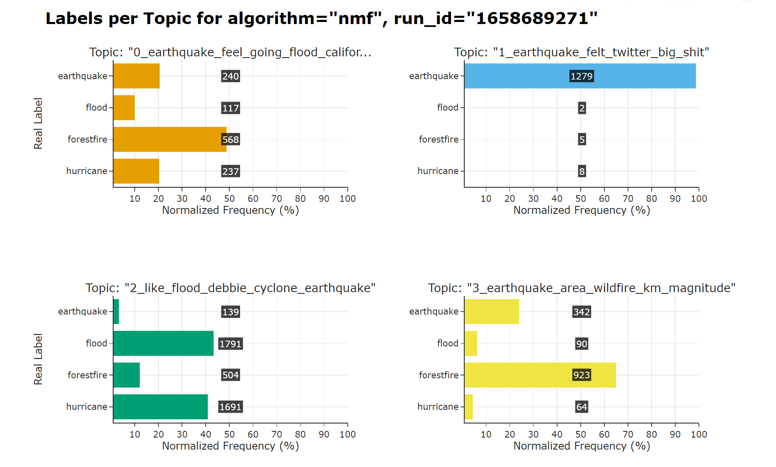
Algorithms – LDA & NMF
Crisis_12
‹#›

Slide 21
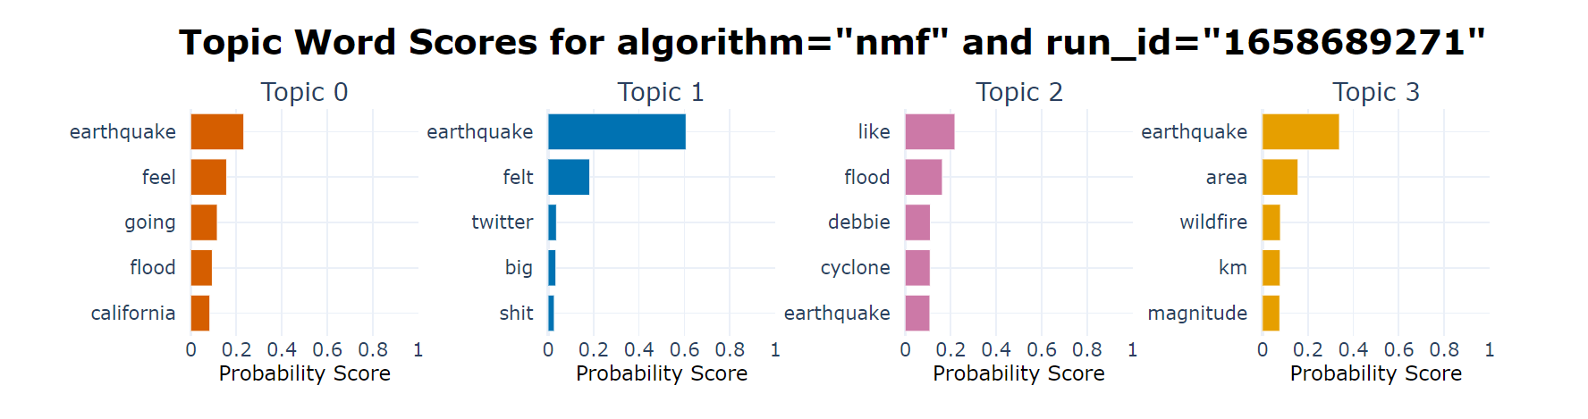
Algorithms – LDA & NMF
‹#›

Slide 22
NMF on Preprocessed and Unpreprocessed Data (Diversity Inv. RBO)
Dataset | Preprocessed | Not Preprocessed
20news | 0.960 | 0.822
ag_news_short | 0.904 | 0.698
crisis_01 | 0.878 | 0.740
crisis_07 | 0.863 | 0.664
crisis_12 | 0.729 | 0.814
crisis_17 | 0.936 | 0.872
yahoo | 0.939 | 0.792
‹#›

Slide 23
Findings and Results
Now show the outcome of your project, that can be:
Performance Evaluation
Output Examples, Small Demo
Theoretical Findings
Discussion
Negative findings are also good!! (E.g. this method does not work)
‹#›

Slide 24
CTM
‹#›

Slide 25
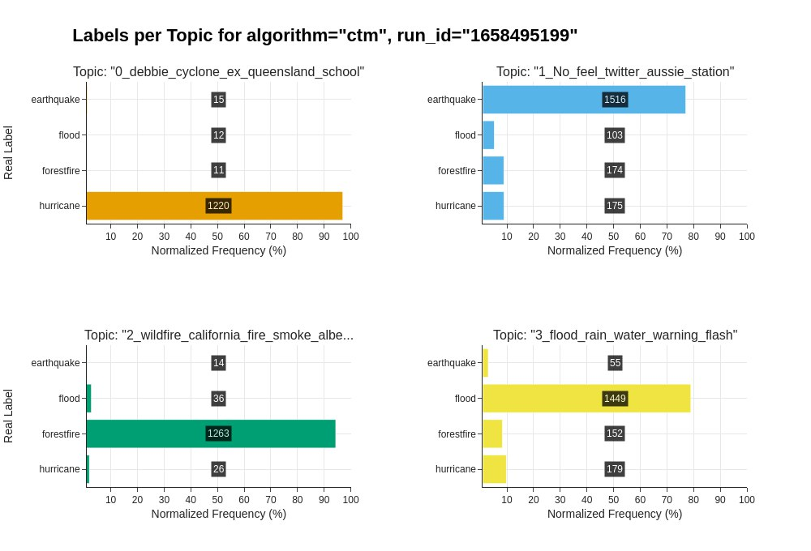
Algorithms – CTM
‹#›

Slide 26
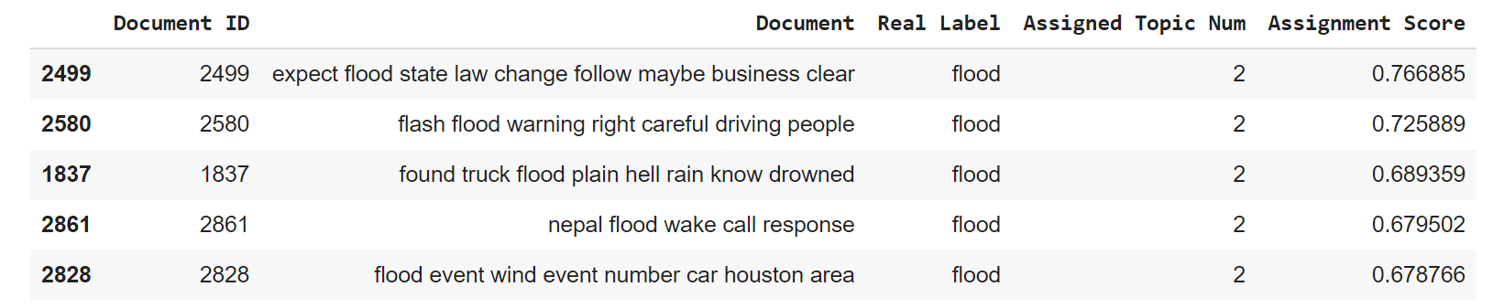
Algorithms – CTM
‹#›

Slide 27
Top2Vec
‹#›

Slide 28
Top2Vec - Available Parameters
Minimum Topic Words: Depends on corpus size and its vocabulary.
Embedding Model: Tested 8 Models
Umap & Hdbscan Args
Number of Topics: Hierarchical Topic Reduction

Slide 29
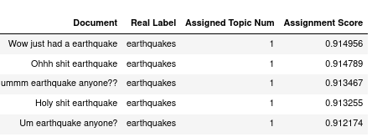
Top2Vec - Topic Assignments with Scores
Parameters: Embedding=”universal-sentence-encoder-large”, Data=”CRISIS-12”
Assignment Score: The cosine similarity of the document and topic vector.
‹#›

Slide 30
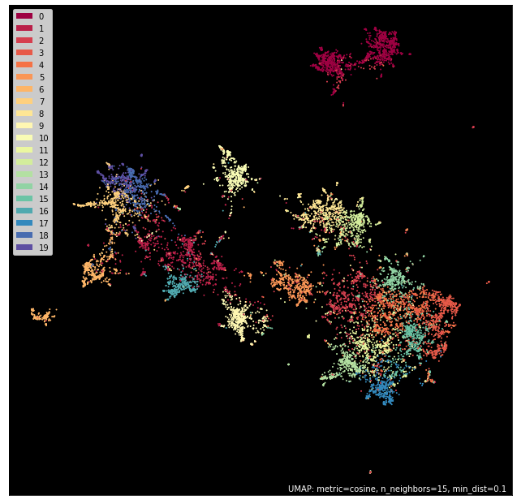
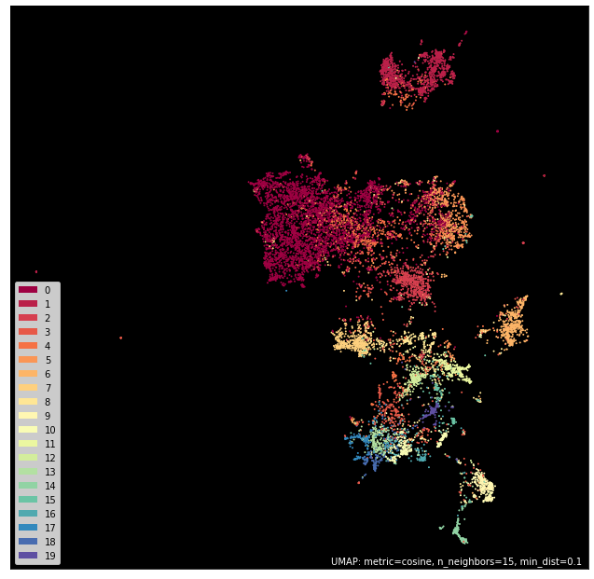
Visualization - UMap
universal-sentence-encoder
all-MiniLM-L6-v2
Advantage: See outliers
‹#›

Slide 31
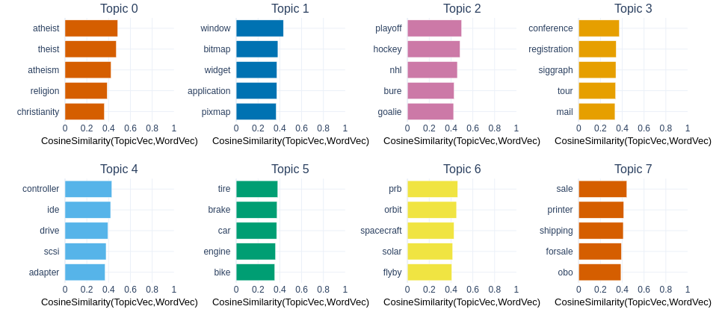
Visualization - Similar Top Topic Words
‹#›

Slide 32
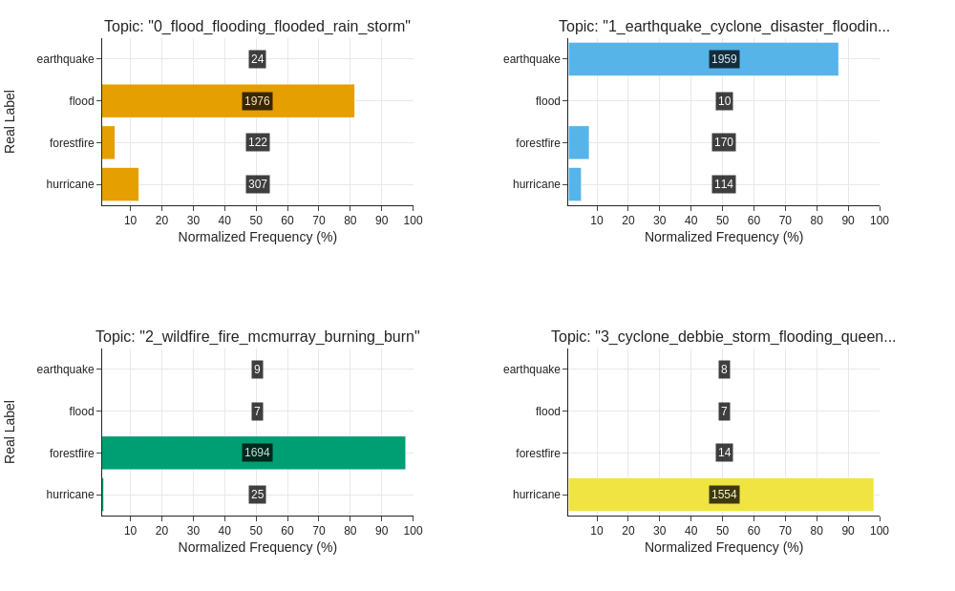
Visualization - Labels per Topic
‹#›

Slide 33
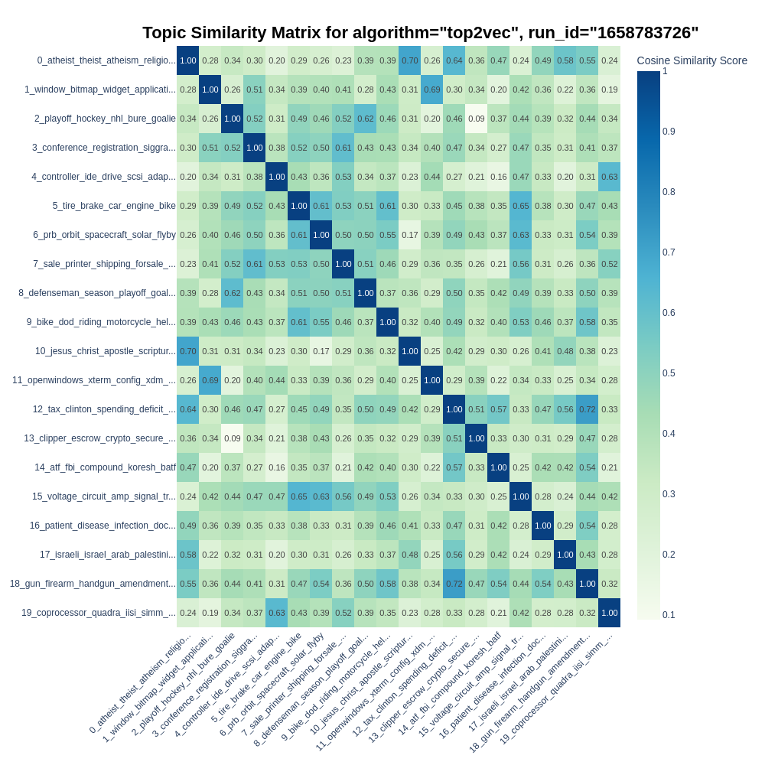
Visualization - Topic Similarity Matrix
‹#›

Slide 34
Top2Vec on Different Embedding Models
 | TD | TD | TC | TC | Cluster
Embedding Model | Unique | Inv. RBO | NPMI | C_V | Rand
all-MiniLM-L6-v2 | 0.907 | 0.957 | -0.284 | 0.388 | 0.864
doc2vec | 0.912 | 0.931 | -0.276 | 0.485 | 0.552
paraphrase-multilingual-MiniLM-L12-v2 | 0.930 | 0.987 | -0.252 | 0.376 | 0.777
universal-sentence-encoder | 0.860 | 0.941 | -0.267 | 0.366 | 0.827
‹#›

Slide 35
BERTopic & LDA-BERT
‹#›

Slide 36
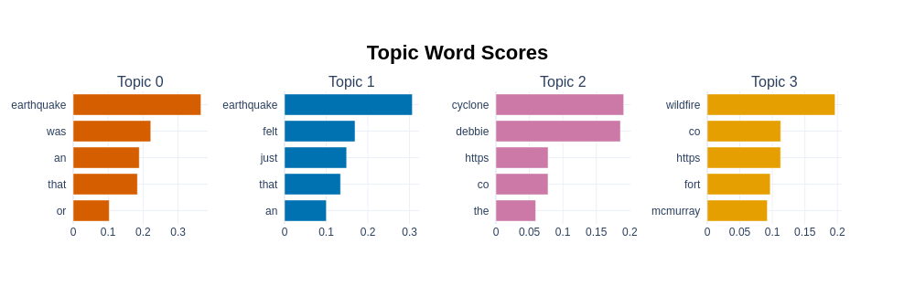
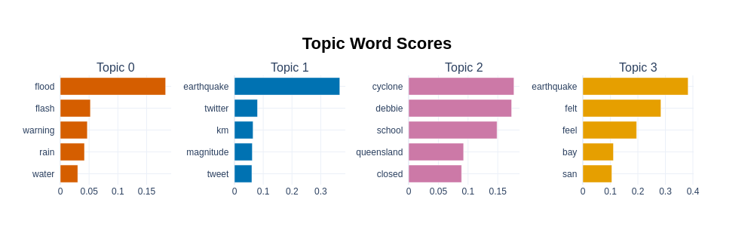
BERTopic - Compare Best Results on Crisis 12
Unprocessed Crisis 12
Preprocessed Crisis 12
Impression: Topic words for the preprocessed version are more descriptive
‹#›
Notes:
Preprocessed topic words are more descriptive;
significant drop in word score after the first topic word for some topics;
NO FORESTFIRE Topic

Slide 37
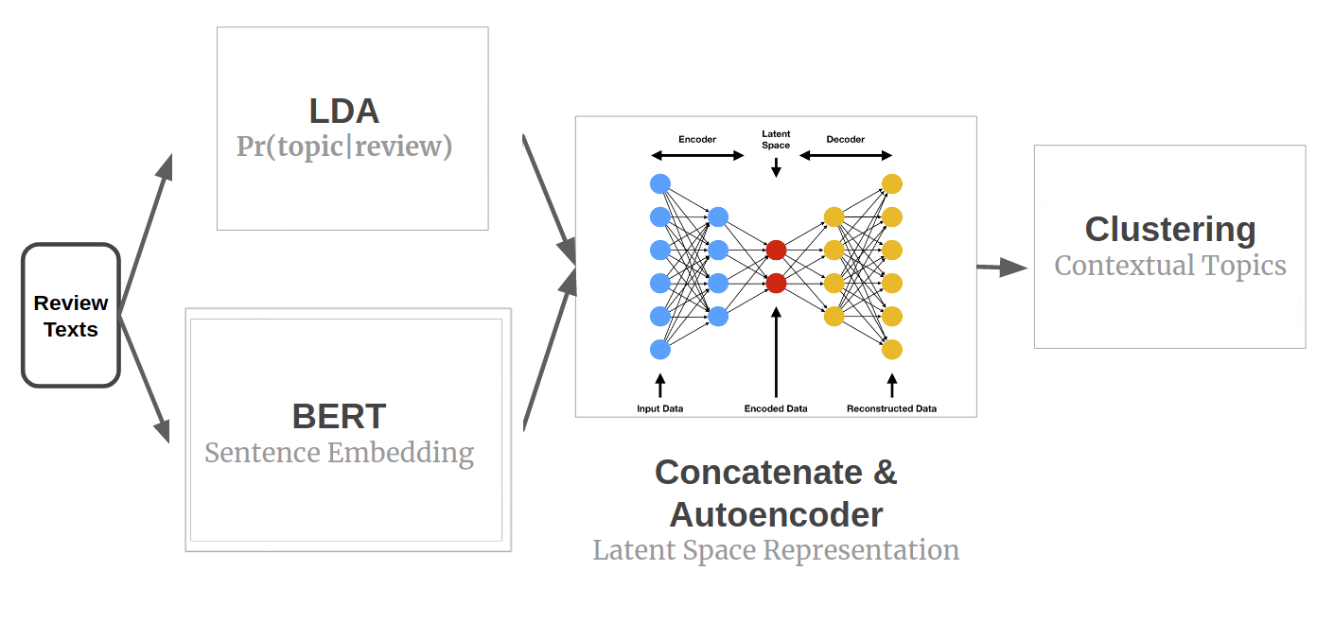
LDA-BERT
An Upgrade: LDA + BERT
Source: https://blog.insightdatascience.com/contextual-topic-identification-4291d256a032
‹#›

Slide 38
Evaluation & Comparisons
‹#›

Slide 39
Evaluation
Give a table with different algorithms and evaluation metrics. Maybe too long to show the result on all the dataset, then at least choose 1 short and 1 long dataset
Gives our conclusion: The ranking of the algorithms for those evaluation, suggest a best performing method
2-3 mins
‹#›

Slide 40
Evaluation: Long Text
 | TD | TD | TC | TC | Cluster
Algorithm | Unique | Inv. RBO | NPMI | C_V | Rand
NMF | 0.565 | 0.805 | 0.035 | 0.508 | 0.846
LDA | 0.525 | 0.878 | 0.038 | 0.538 | 0.792
LDA-BERT | 0.397 | 0.661 | 0.055 | 0.594 | 0.880
BERTopic | 0.637 | 0.828 | 0.081 | 0.577 | 0.425
Top2Vec | 0.819 | 0.902 | -0.113 | 0.436 | 0.906
CTM | 0.552 | 0.909 | -0.056 | 0.404 | 0.861
‹#›

Slide 41
Evaluation: Short Text
 | TD | TD | TC | TC | Cluster
Algorithm | Unique | Inv. RBO | NPMI | C_V | Rand
NMF | 0.718 | 0.715 | -0.014 | 0.388 | 0.614
LDA | 0.700 | 0.810 | 0.010 | 0.435 | 0.625
LDA-BERT | 0.743 | 0.778 | -0.001 | 0.421 | 0.727
BERTopic | 0.826 | 0.901 | 0.050 | 0.493 | 0.474
Top2Vec | 0.897 | 0.956 | -0.279 | 0.388 | 0.739
CTM | 0.966 | 0.994 | -0.100 | 0.486 | 0.746
‹#›

Slide 42
Take-Aways
‹#›

Slide 43
Take-Aways
Embedding based models perform better
Winners on Short Data:
CTM & BERTopic
Winners on Long Data:
CTM & Top2Vec
‹#›

Slide 44
Challenges and Future Research
What was hard in your project?
What was a failure and what a success?
If someone were to continue your work, what should they focus on?
‹#›

Slide 45
Take-away and References
What did you learn?
Share with us the most useful papers and resources you have found :)
‹#›

Slide 46
Challenges and future work
Limited computing resource
Whole pipeline creation
LDA-BERT Realization
Unsupervised
Slow CTM
Make the work to a real topic modelling tool (in Github)
‹#›

Slide 47
Q & A
‹#›

